Slide 1
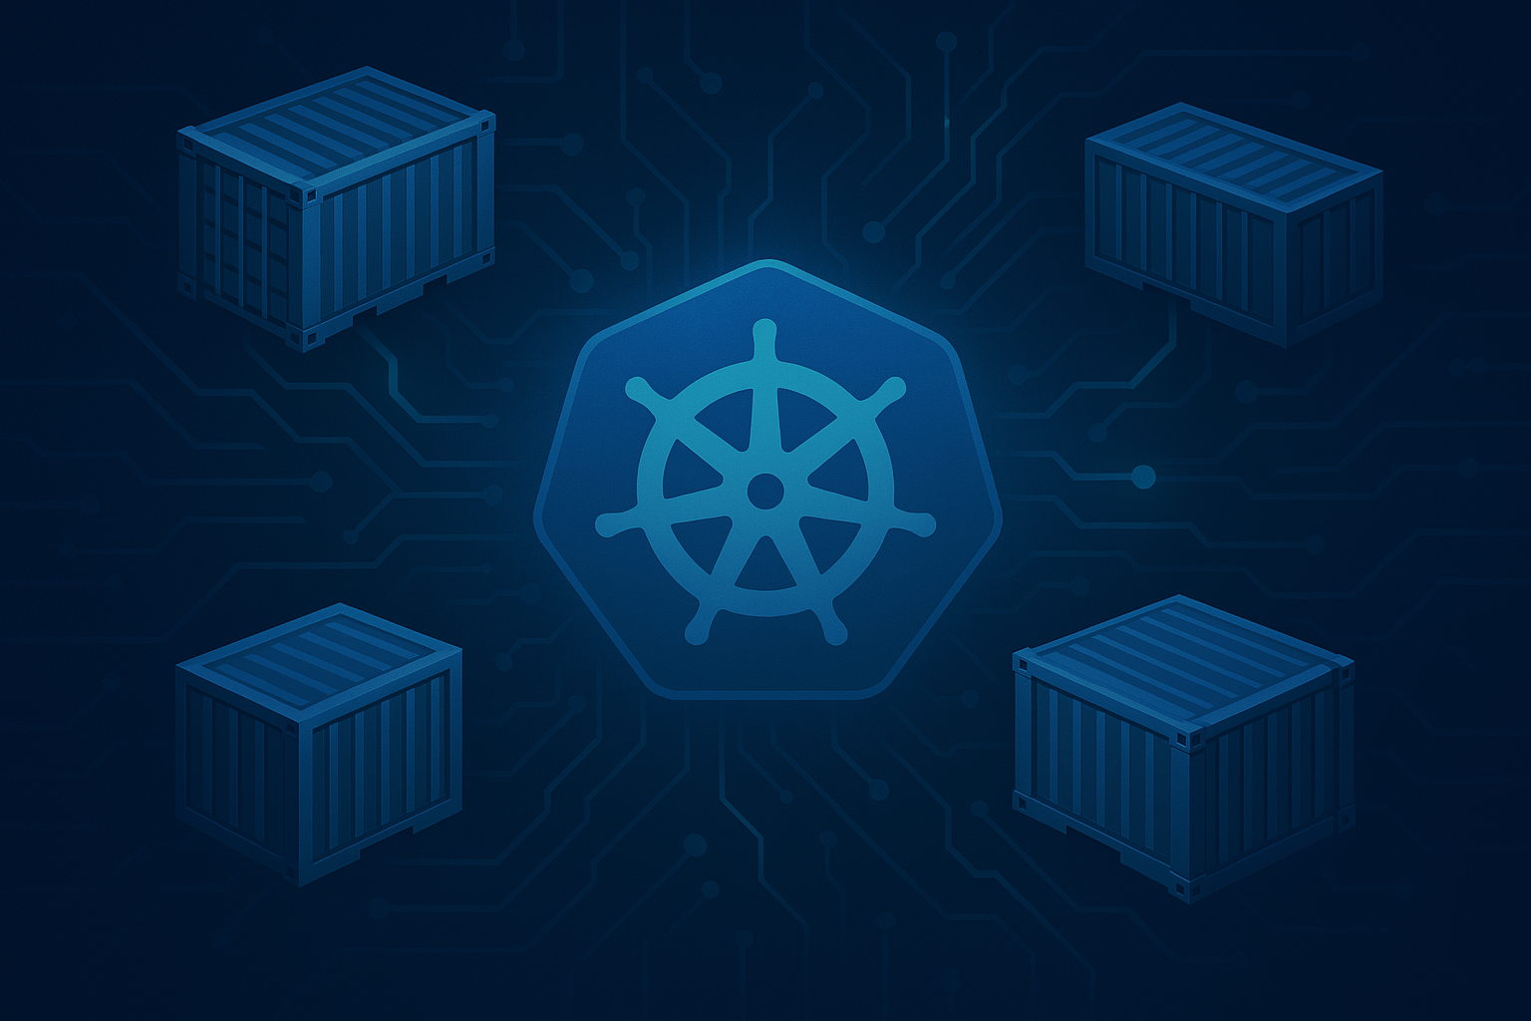
Kubernetes Technical Primer
Ben Coleman
Feb 2026

Slide 2
What Does This Primer Cover?
Why Kubernetes The purpose and value of Kubernetes for orchestration, and when it's the right (or wrong) choice
Building Blocks The core objects and primitives that make up every Kubernetes cluster and what they mean
Day-to-Day Operation & Use How to deploy, configure, and manage workloads in practice
Going Deeper Networking, security, the wider ecosystem, and how to debug when things go wrong
Scaling Strategies for scaling workloads and infrastructure automatically
Extensibility How Kubernetes can be extended with add-ons, extensions & custom resources and operators
DevOps & Observability Tooling and practices around CI/CD, monitoring, and configuration management
Azure Kubernetes Service Using Kubernetes as a managed service on Azure with AKS

Slide 3
Introduction To Kubernetes
Why Kubernetes?
Core Concepts and Terms
Simplified Architecture
Internal Architecture
Highly Extensible
When To Use Kubernetes
Core Components
Pods
Deployments & Replica Sets
Services
Services – Simplified Illustration
DNS and Service Discovery
Data Volumes & Mounts
Persistent Volumes
Stateful Sets
Daemon Sets
Jobs & CronJobs
Namespaces
Role Based Access Control (RBAC)
Putting It All Together
Using Kubernetes
Command Line - kubectl
Kubectl – Common Commands
Kubernetes Declarative Model
Idempotent Updates & Desired State
Labels & Selectors
Configuring Basic Workloads
Environmental Variables
Secrets
ConfigMaps
Resource Management
Probes
Container Arguments
Beyond The Basics
Kubernetes Ecosystem
The Kubernetes API
Container Runtimes & Tooling
Additional Network Topics
Ingress
Gateway API
Network Policies
External DNS
Cert Manager
Service Mesh
Putting It All Together
Debugging and Troubleshooting Workloads
Describing Objects
Container Logs
Debug & Get Shell Access
Advanced Pod Configuration
Deeper Dive on Manifests
Init Containers
Sidecars
Node Selector
Affinity and Taints
Pod Security
Scaling
Manually Scaling
Horizontal Pod Autoscaler (HPA)
Cluster Autoscaler (CA)
KEDA
Extending Kubernetes
Custom Resource Definitions
Operators
DevOps & Observability
Common DevOps Containers Lifecycle
GitOps
Modern Observability Stack
Helm Introduction
Helm – The Basics
Kustomize
Azure Kubernetes Service
Managed Kubernetes on Azure – AKS
AKS Networking
Microsoft Entra Workload ID
Microsoft Entra ID for RBAC
Azure Monitor Container Insights
Cluster Auto Scaler
TABLE OF CONTENTS

Slide 4
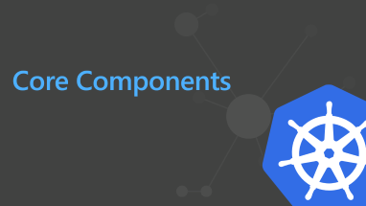
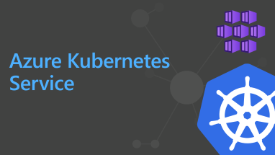
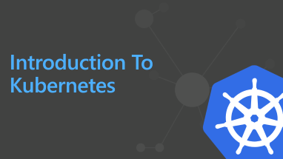
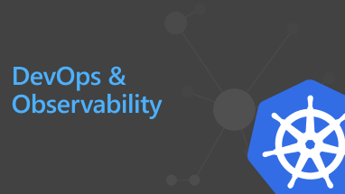
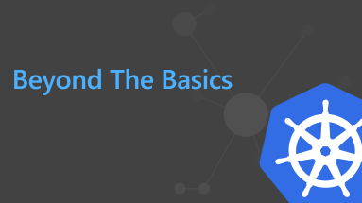
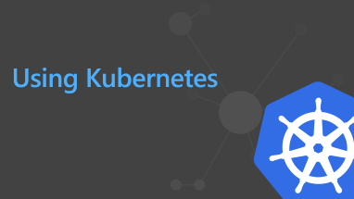
MAIN SECTIONS

Slide 5
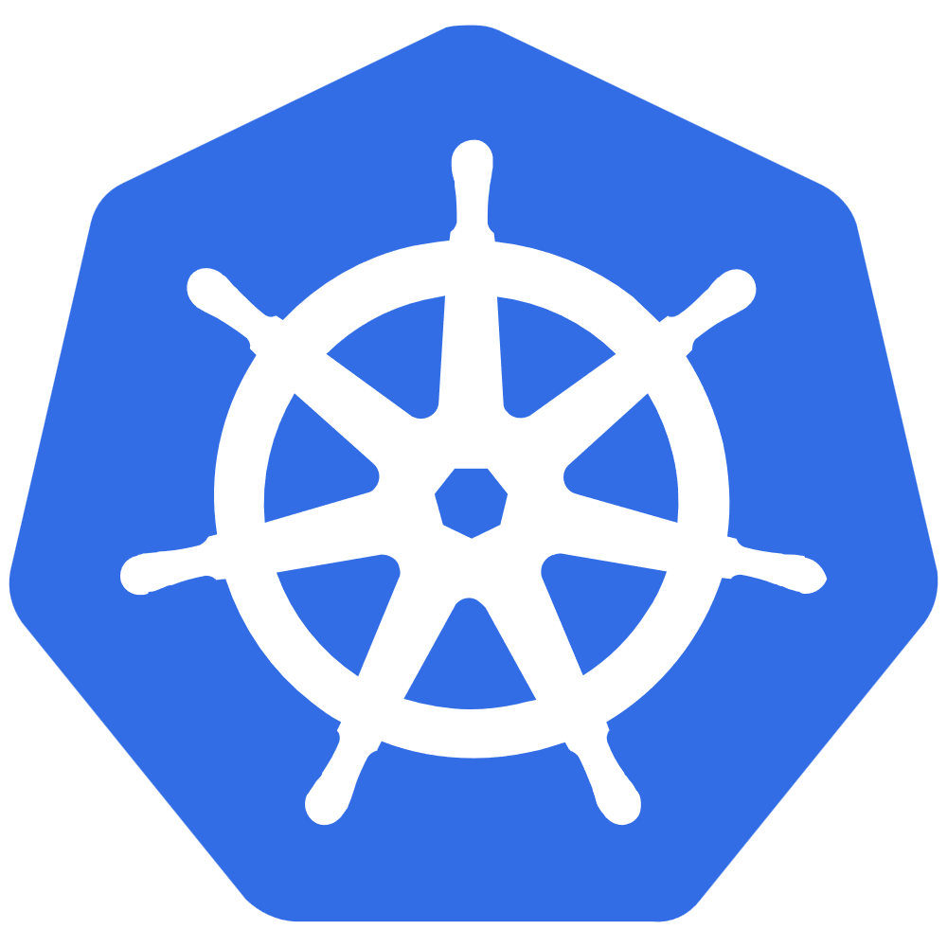
Introduction To Kubernetes

Slide 6
Why Kubernetes?
Deploy and manage containerized applications at scale
Scale workloads dynamically based on demand
Provide service discovery and load balancing
Automate rollouts, rollbacks, and self-healing
Run on any infrastructure – cloud, on-prem, or hybrid
Enforce security policies and access control
Extend with a rich ecosystem of tools and integrations
Modern declarative configuration and APIs

Slide 7

Core Concepts and Terms
Nodes Worker machines capable of running pods
Deployments Manages a replicated application, via a set of pods
Namespaces Logical separation for resources
Pods A group of one or more containers that is lifecycle managed
Services Network access to a resource, e.g. pod or port. Typically load balanced
Config Maps / Secrets Configuration for your workloads and apps

Slide 8


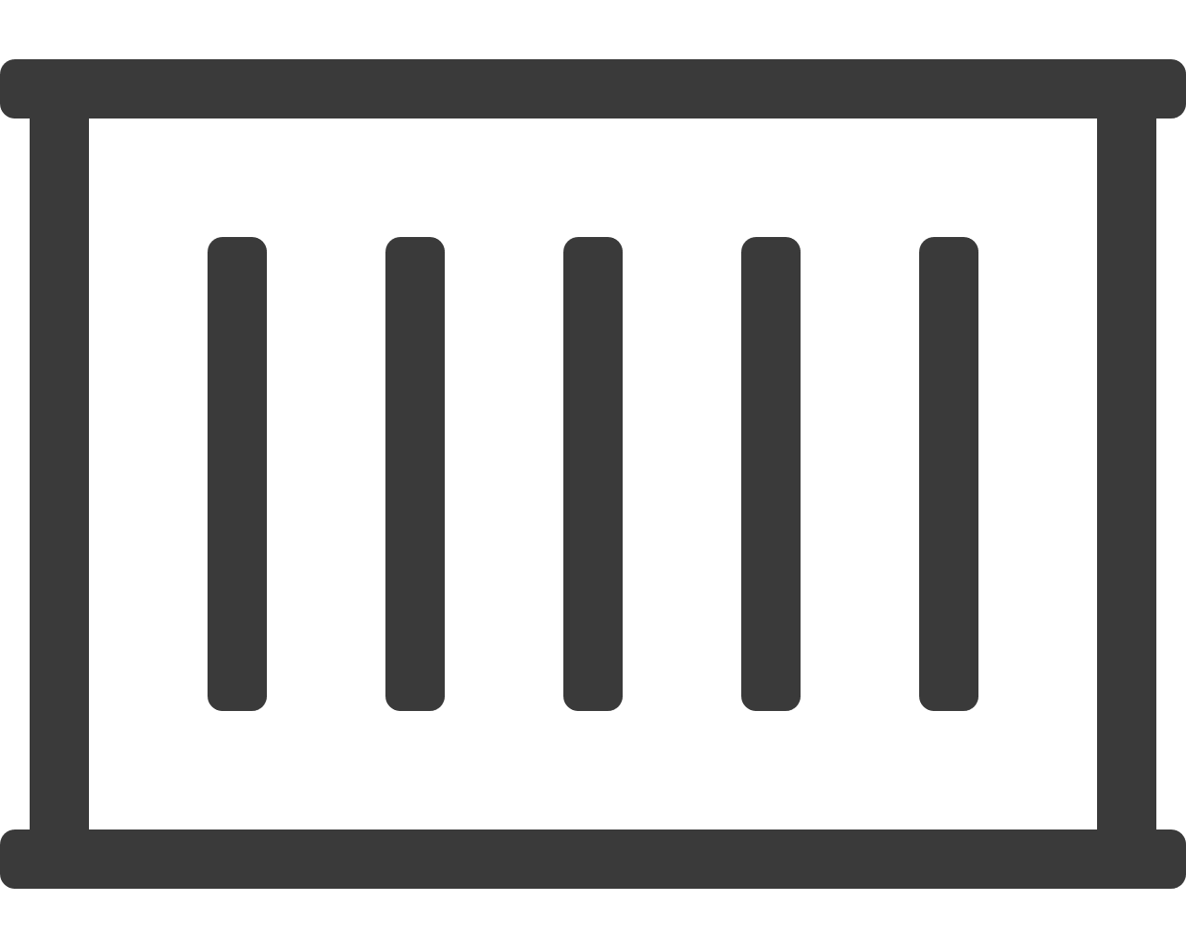
Highly Simplified Architecture
Kubernetes
Services
Your Cluster
( your apps/workloads )
Pods
Users
Control Plane
API
Controllers
Nodes + Container Runtime
Developers
& Admins
Image Registry

Slide 9


Internal Architecture
Kubernetes
Cluster
Node
Users
kubelet
Container Runtime
Pod
Pod
Exposed services
…
kube
proxy
Pod
Control Plane
…
API Server
Scheduler
Node
Controller Manager
kubelet
Container Runtime
Pod
Devs / Operators
etcd
Pod
…
Cloud Controller
kube
proxy
Pod
Cloud Provider APIs

Slide 10


Highly Extensible
Kubernetes Tool Box
Kubernetes does not provide everything “out of the box”
Extendable by design – many optional components
Defers to addons and extensions for specific tasks
Auto Scalers
Log Collection
Monitoring
TLS Cert Manager
Dashboards
Ingress
External DNS
Admission Controller
Service Mesh
Helm

Slide 11


When To Use Kubernetes
No guide to Kubernetes is complete without a warning!
Simple app / small team, here the operational overhead of Kubernetes outweighs the benefits
No scaling needs, if you have predictable, small workloads it doesn’t justify the complexity
Kubernetes has a VERY steep learning curve, skills gap could lead to fragility, mistakes and slow you down
Kubernetes is NOT a PaaS! You want PaaS and don't want to manage infrastructure, go elsewhere
Multiple services/teams; and need independent deployment & scaling between them
Scaling & resilience; you need autoscaling, self-healing, rolling updates
You’re deploying multiple tightly coupled services, but don’t kid yourself that your API + backend is microservices!
Portability across clouds or on-premises
Already containerized; you’ve invested in containers and CI/CD already
REASONS TO AVOID
YOU MIGHT NEED KUBERNETES
Kubernetes solves orchestration problems, if you don't have these problems, you don't need Kubernetes. Start simple, adopt when the pain of not having it becomes real

Slide 12
Core Components

Slide 13
Pods
Fundamental building block of Kubernetes
port: 8080
10.0.4.58
Pod
Pods run one or more containers
Containers in a pod share network/storage
Pods each have their own IP address
Pods expose one or more ports
Pods are scheduled and run on a Node
port: 8080
Container
A
Container B
shared network & filesystem
Example Pod
Pods are the primary way of running your workloads in Kubernetes

Slide 14
Deployments & Replica Sets
Scale and run pods across multiple nodes
Deployment
- name: MyApp
- replicas: 3
Deployments describe a replicated set of Pods
A Deployment represents desired state - Rolling updates used to safely roll out changes
You scale Deployments up & down
Deployments typically run stateless workloads
Deployments use ReplicaSets
ReplicaSet
- replicas: 3
pods
Deployments let you run & scale stateless workloads in Kubernetes

Slide 15
Services
Network access to Pods
Pods are ephemeral - they can move/die/change without notice. In general, users do not directly access Pods
Services are an abstraction which defines a logical set of Pods and a policy by which to access them
Services use labels and selectors to map to Pods
Services are assigned IP addresses and DNS names
Network Traffic
Service
pods
Services are how you connect to Pods over the network

Slide 16
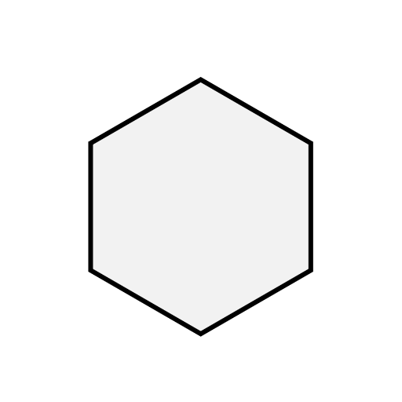

Services – Simplified Illustration
Allow virtual network access to one or more pods
label=myApp
kubeproxy
Service
Node 1
myApp
myApp
iptables
Service IP
selector: myApp port: 80 targetPort: 5000
kubeproxy
iptables
Node 2
myApp
EXTERNAL
INTERNAL
LoadBalancer
Uses cloud provider to present an external load-balanced IP
ClusterIP
Internal virtual IP, only accessible by other pods/services

Slide 17
DNS and Service Discovery
Naming for Pods and Services
$ nslookup myapp
Address: 10.200.4.30
DNS in cluster is handled automatically by Kubernetes
All ClusterIP (internal) Services get assigned a DNS record based on the service’s name
Pods also get DNS names, but this is less useful
External public DNS can also be configured – See “Additional Network Topics” section later
Service
- name: myapp
Service IP: 10.200.4.30
pods
Connect to your workloads using DNS and Services

Slide 18

Data Volumes & Mounts
Handling State & Data
Pod
Filesystem of running containers is ephemeral. All data written will be lost on a restart
Use Volumes to hold data or state you want to keep, or to inject data into a Pod
Volumes are mounted into a container at a mountPath
Many types of storage can be used to back the Volume
Container
/opt/data
Container
/var/www
Volume
datavol
Warning! A volume shares lifecycle with the Pod, so are not persistent
Volumes hold data and state for Pods and containers

Slide 19
Persistent Volumes
Pod
Handling State & Data
Container
/opt/data
Container
/var/www
A PersistentVolume allows you to hold data independent of Pod lifecycle
A pod uses a PersistentVolumeClaim to bind to a PersistentVolume - ReadWriteOnce - mounted on a single Node (e.g. db) - ReadWriteMany - mounted on multiple Nodes
Many storage plugins exist: NFS, iSCSI, Azure (Disk & Files), CSI, Ceph, Gluster, AWS
Volume
datavol
PersistentVolumeClaim
PersistentVolume
pv1
Persistent Volumes retain data long term, outside of Pods

Slide 20
Stateful Sets
Handling Stateful workloads
StatefulSet
- name: MyDbSet - serviceName: "mongo"
- replicas: 2
A StatefulSet is like a Deployment except Pods get well defined names and replicas start in ordered sequence
StatefulSets retain identity regardless of which Node they run on
Each Pod in a StatefulSet will bind to the same defined PersistentVolumeClaim
mongo-0
mongo-1
pvc-mongo-0
pvc-mongo-1
Use a StatefulSet rather than Deployment for stateful workloads

Slide 21
Daemon Sets
Running Pods across all Nodes
A DaemonSet ensures that all Nodes in the cluster run a given Pod. Pods will be created/removed as Nodes are added/removed
Used for special system and cluster daemons, logging, storage, etc.
DaemonSets are not often used for normal app workloads
Node
1
Node
2
Node
n
DaemonSet
DaemonSets run system Pods for monitoring & network

Slide 22
Jobs & CronJobs
kind: Job
spec:
completions: 1
parallelism: 3
Workloads that run to completion
A Job creates one or more pods and ensures that a specified number of them successfully terminate
Jobs can run in serial or parallel
Control of number of failures, completions, restart policy and level of parallelism
CronJobs allows you to schedule Jobs to be run
Job
c1
c2
c3
c3 → Terminated: Complete Job → Successful
Use Jobs for any workloads that run in batch or perform one off tasks

Slide 23
Namespaces
Logical Separation & Cluster Organisation
Kubernetes Cluster
Most Kubernetes objects live inside a Namespace
Kubernetes starts with two Namespaces: default and kube-system
You can create Namespaces to logically partition a cluster, e.g. for dev/test or different customers
Nodes will be shared across Namespaces
A namespace does not provide isolation & multi-tenancy
Namespace
“alpha”
Namespace
“beta”
pod
pod
pod
svc
Node
1
Node
2
Node
3
When first learning Kubernetes use the default Namespace

Slide 24



Role Based Access Control (RBAC)
User
ServiceAccount
Regulating & governing access
RBAC controls user and system access to the API and Kubernetes resources
Roles define privileges as sets of verbs and API resources
RoleBinding grants Roles to Users and ServiceAccounts
RoleBinding
kind: Role
name: pod-reader
rules:
resources: ["pods"]
verbs: ["get", "watch", "list"]
get, delete, create, list, update, watch
Verb:
pods, secrets, services,
jobs, nodes, ingresses
Note. Kubernetes doesn’t include a native identity system or a way to manage end user accounts
API:
RBAC is optional, but a standard feature for any new cluster

Slide 25

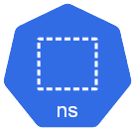
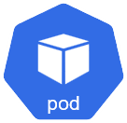
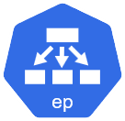
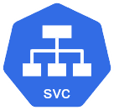
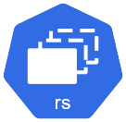
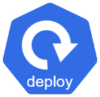
Putting It All Together
Sample Architecture – Simple App
Basic web application
Running in 3 pods via a Deployment and ReplicaSet
With LoadBalancer service and external IP
namespace: default
External IP

Slide 26
Using Kubernetes

Slide 27
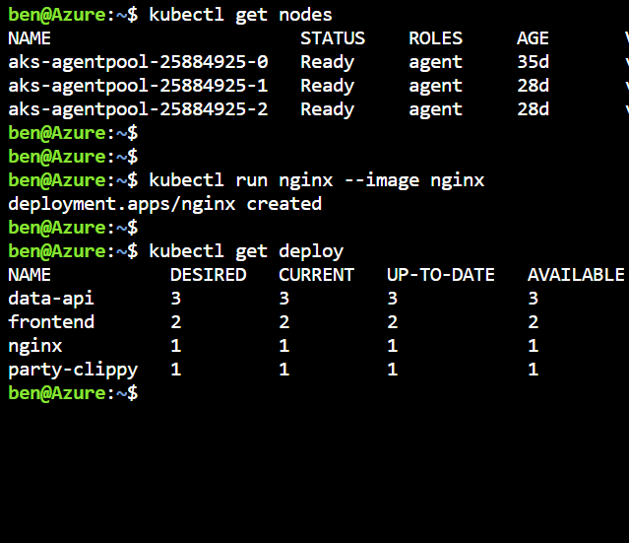
Command Line - kubectl
Main management & control interface to Kubernetes
Can manage multiple clusters
Secure interface to Kubernetes API
Used for *everything* cluster ops and application deployment & management

Slide 28

Kubectl – Common Commands
get
delete
apply
describe
…others…
Display one or many resources
Delete resources
Create resources from manifests
Get details of any resource
Some other commands
get nodes
get pods
get all
get pod pod123
get nodes -w
delete deploy mydeploy
delete -f myapp.yaml
delete -l app=foo
apply -f myapp.yaml
apply –f ./stuff
apply –f http://example.net/app.yaml
describe pod pod138
describe svc myservice
describe pod -l app=myapp
logs pod138
rollout restart deploy mydeploy
exec pod138 -- ls
kubernetes.io/docs/reference/kubectl/cheatsheet
Set up aliases & autocomplete!
kubernetes.io/docs/reference/kubectl/overview

Slide 29
Kubernetes Declarative Model
YAML or JSON documents
Describe any Kubernetes object
Objects & properties map directly to the Kubernetes API
You can combine multiple objects into a single file (separate with ---)
kind: Deployment
apiVersion: apps/v1
metadata:
name: mydeploy
spec:
replicas: 4
selector:
matchLabels:
app: myapp
template:
metadata:
labels:
app: myapp
spec:
containers:
- name: mycontainer
image: bencuk/vuego-demoapp
ports:
- containerPort: 4000
This is a deployment object, called ‘mydeploy’
It will run 4 replicas of a pod matching the label app=myapp
Each pod will be labelled with app=myapp and
Runs a container from image bencuk/vuego-demoapp
Port 4000 will be exposed from the container
Note. JSON is also supported, but YAML is recommended for readability

Slide 30

Idempotent Updates & Desired State
Files describe desired state of the resources you configuring
kubectl apply
Kubernetes applies updates in idempotent way, modifying objects only if needed
$ kubectl apply –f myconfig.yaml
deployment.apps/mydeploy created
$ nano myconfig.yaml
myapp.yaml
spec:
replicas: 4
spec:
replicas: 2
$ kubectl apply –f myconfig.yaml
deployment.apps/mydeploy configured
Idempotency: “The definition of the target state can be applied multiple times and if the system’s state is unchanged, no changes are made to the system”

Slide 31

Labels & Selectors
kubernetes.io/docs/concepts/overview/working-with-objects/labels
Kubernetes makes extensive use of labels and selectors
Labels are metadata on any object and are just key+value pairs of your choosing
Selectors are lookups that match one or more objects based on their labels
kind: Deployment
...
metadata:
labels:
app: myapp
type: frontend
---
kind: Service
spec:
type: LoadBalancer
selector:
app: myapp
This is a deployment labels its pods with app: myapp & type: frontend
This service will look for any pods labelled with app=myapp
Note. There might be zero, one or many matches
Uses
- Which Pods are in a Service - Which Nodes to run a Pod on - Which Pods are in a Deployment - Logically group & tag resources

Slide 32
Configuring Basic Workloads

Slide 33
Environmental Variables
kubernetes.io/docs/tasks/inject-data-application/define-environment-variable-container/
Environmental variables are the standard way to configure containers at runtime
Containerized app consumes environmental variables in OS standard way
Key value pairs
Application/container specific
apiVersion: v1
kind: Pod
metadata:
name: envar-demo
labels:
purpose: demonstrate-envars
spec:
containers:
- name: envar-demo-container
image: gcr.io/google-samples/node-hello:1.0
env:
- name: DEMO_GREETING
value: "Hello from the environment"
- name: DEMO_FAREWELL
value: "Such a sweet sorrow"
Uses
Application configuration
Parameter passing

Slide 34
Secrets
kubernetes.io/docs/concepts/configuration/secret
Hold sensitive information such as passwords, certs and API keys
Don’t place sensitive values as plain text in deployment files
Don’t “bake” secrets into your container images with config files
Can be mounted in pods as files or environmental variables
$ kubectl create secret generic my-secret --from-literal connString='admin:superSecret@some-host'
secret/my-secret created
myapp.yaml
containers:
- name: my-web-server
env:
- name: DATABASE_CONNECTION_STRING
valueFrom:
secretKeyRef:
name: my-secret
key: connString
Uses
TLS certificates
Application configuration
Authentication with private registry

Slide 35
ConfigMaps
kubernetes.io/docs/tasks/configure-pod-container/configure-pod-configmap
Hold application configuration data
Key value pairs (like secrets), YAML or free format (e.g. XML, conf)
Pass to containers as env vars or mount as volume
$ kubectl create configmap my-config --from-file=/path/to/foobar.conf
configmap/my-config created
myapp.yaml
containers: - name: my-foobar-server
volumeMounts:
- name: config-vol
mountPath: /etc/config
volumes:
- name: config-vol configMap: name: my-config
Mount into container at given path
Uses
Application configuration
Reference to config map object

Slide 36
Resource Management
kubernetes.io/docs/concepts/configuration/manage-compute-resources-container
Define compute (CPU & memory) resource limits and requests for containers
Allows Kubernetes to make better scheduling placement decisions
Limits are enforced, requests aren’t
CPU resources are fractions of 1 vCore
apiVersion: v1
kind: Pod
metadata:
name: demo-app
spec:
containers:
- name: db
image: mysql
resources:
requests:
memory: "64Mi"
cpu: "0.25"
limits:
memory: "512Mi"
Uses
Efficient use of cluster resources
Prevent rogue workloads starving the cluster
Good practice
Certain capabilities such as auto scaling are dependant on setting resources
Specifying limits & requests is optional but STRONGLY recommended

Slide 37
Probes
kubernetes.io/docs/concepts/configuration/liveness-readiness-startup-probes/
Readiness probes tell Kubernetes your container is ready to accept traffic
Liveness probes tell Kubernetes to restart your container, use with caution
Startup probes disable checks until the app is initialised
Probes can be HTTP, TCP or execute commands
...
readinessProbe:
httpGet:
path: /status
port: 8080
initialDelaySeconds: 25
periodSeconds: 10
failureThreshold: 3
...
livenessProbe:
exec:
command: ["mysqladmin", "ping"]
initialDelaySeconds: 30
periodSeconds: 20
Specifying a readiness probe is highly recommended
Uses
Maintain availability
Restart unhealthy containers
Efficient traffic routing
Specifying a liveness probe is optional and can cause side effects

Slide 38
Container Arguments
kubernetes.io/docs/tasks/inject-data-application/define-command-argument-container/
Use args to pass arguments to the container, pass an array of strings
Use the command property to override the starting command in a container. Rarely used.
Note. These correspond to the Docker Entrypoint and Cmd parameters
kind: Pod
metadata:
name: command-demo
spec:
containers:
- name: command-demo-container
image: debian
command: ["printenv"]
args: ["HOSTNAME", "KUBERNETES_PORT"]
Description | Docker field name | Kubernetes field name
The command run by the container | Entrypoint | command
The arguments passed to the command | Cmd | args
Uses
Use base images to run utilities & scripts
Debugging & trouble shooting
Application configuration
Parameter passing

Slide 39
Beyond The Basics

Slide 40
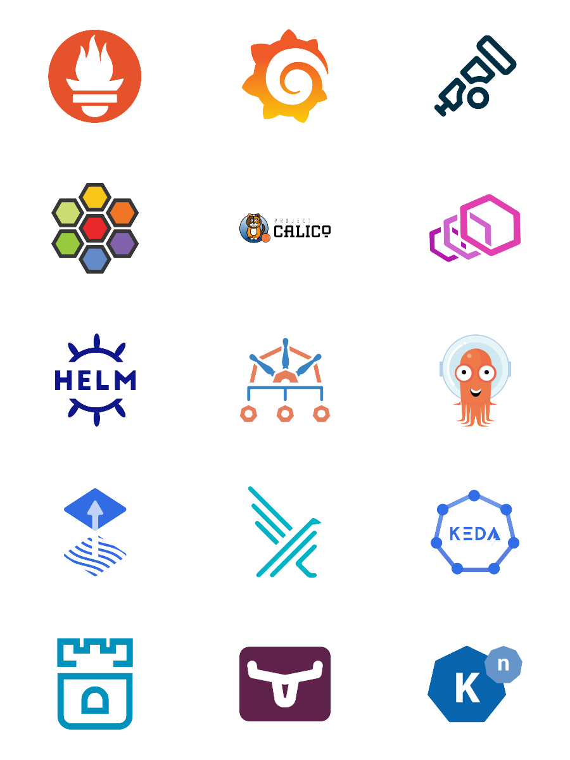
Kubernetes Ecosystem – Many Projects
Monitoring & Observability | Prometheus, Grafana, OpenTelemetry
Network Plugins (CNI) | Cilium, Calico
Ingress & Traffic | NGINX Ingress, Gateway API, Envoy
Service Mesh | Istio, Linkerd, Cilium
Storage | Rook, Longhorn
Security & Policy | Kyverno, Gatekeeper, Falco
Package Mgmt & Config | Helm, Kustomize
GitOps & CD | Argo CD, Flux
Autoscaling | KEDA
Secrets Management | External Secrets Operator
Serverless | Knative
landscape.cncf.io

Slide 41
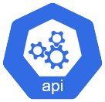
The Kubernetes API
kubernetes.io/docs/reference/#api-reference
It’s Kind Of Important!
Every object in Kubernetes and any interactions with the cluster are shaped by the API and the API spec - YAML manifests schema - kubectl commands
Served by the API server running on control plane node(s)
Kubernetes version dependant
Aggregated – single API server endpoint fronts multiple versioned APIs, and it's extensible both via CRDs and via API aggregation
kubectl proxy – Create a local tunnel to the API server if you want to get your hands dirty

Slide 42
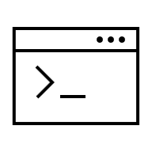
Container Runtimes & Tooling
It’s not about Docker anymore
Containerd Lightweight, stable, CNCF graduated. Now the standard CRI runtime on all major K8s platforms
CRI-O Built specifically for Kubernetes by Red Hat. Minimal and purpose-built
Container Runtimes
Kubernetes can use different container runtimes via something called the Container Runtime Interface (CRI)
Kubernetes has used containerd as its default container runtime since 1.24, when Docker support was removed in 2022
The runtime executes containers on nodes, while CLI tools (Docker, Podman, nerdctl) are used by developers to build, push, and test container images locally. Kubernetes only cares about the runtime, not how the image was built.
Docker Most widely known container tool. Includes CLI, and engine. Still the most popular choice for local dev and CI pipelines. Requires a paid subscription for commercial use
Podman Daemonless, rootless Docker alternative from Red Hat. Drop-in replacement for the docker Fully open source (Apache 2.0) no licensing restrictions.
Nerdctl Docker-compatible CLI for containerd. Gives you the familiar docker commands but talks directly to containerd. Fully open source (Apache 2.0) no licensing restrictions.
Container Tools

Slide 43
Additional Network Topics

Slide 44

Ingress
External access & routing for HTTP and HTTPS
An Ingress allows you to route HTTP/HTTPS traffic to services based on URL path and/or domain host name
Ingress object is a set of rules picked up and implemented by the Ingress Controller
Ingress Controller has a public IP and LoadBalancer service, it routes traffic to internal ClusterIP services
A large choice of controllers are available, e.g. NGINX, Envoy, HAProxy, Traefik
Ingress
/site/live
/site/test
pod
pod
Use an Ingress when you want to route HTTP(S) traffic into your workloads and pods

Slide 45
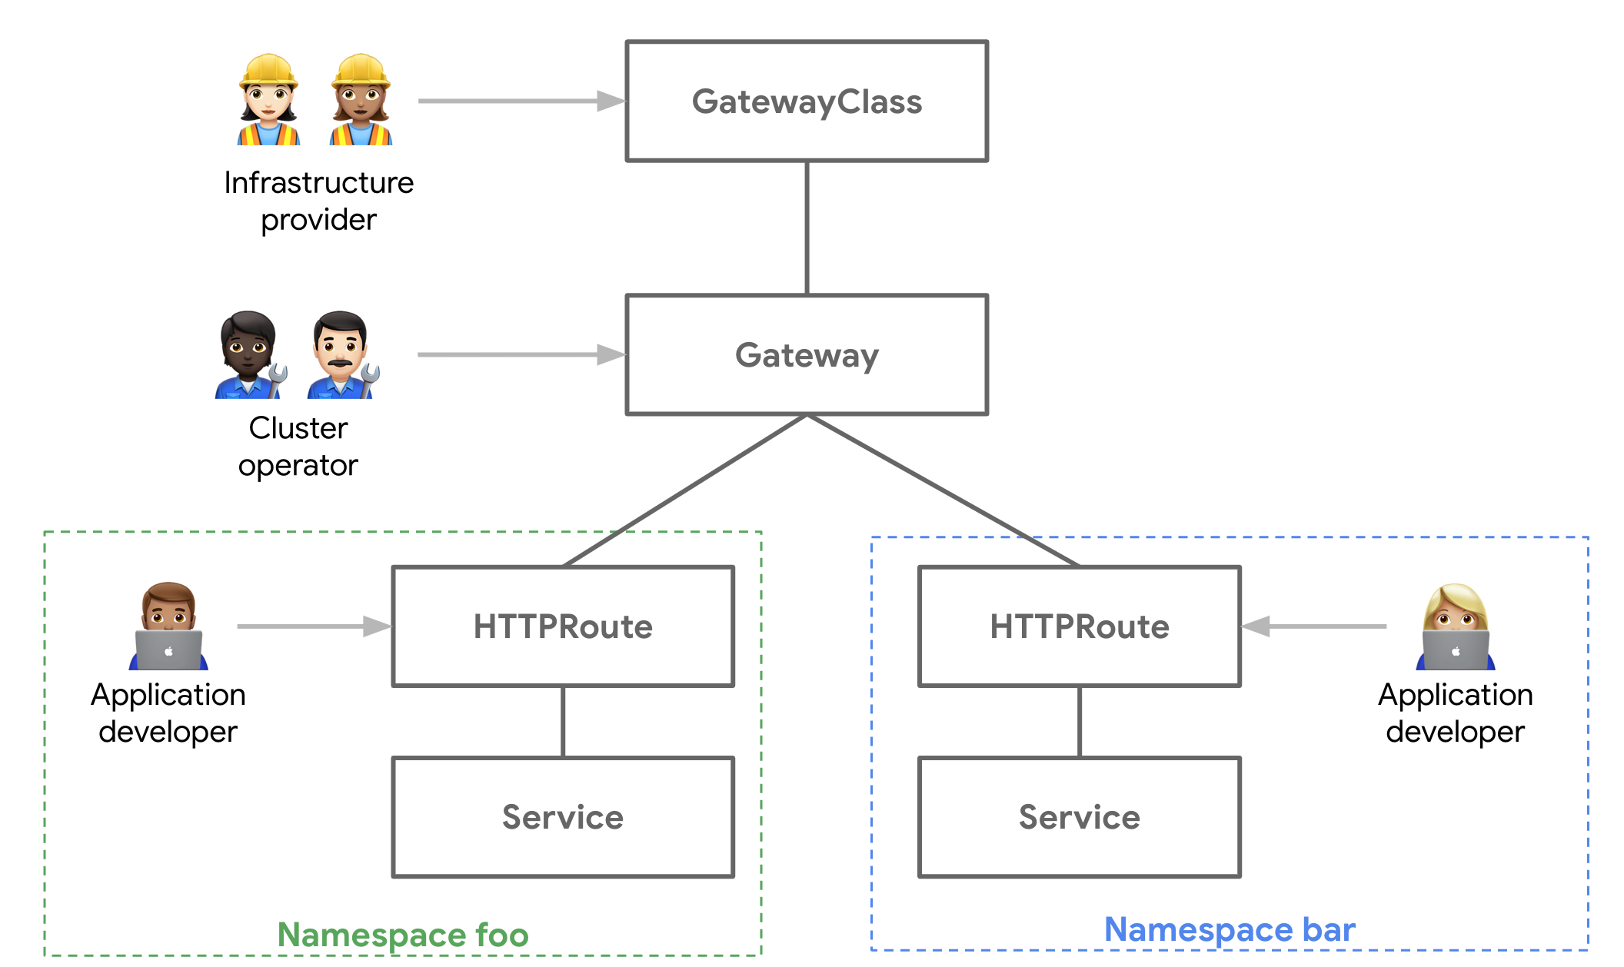
Gateway API
Do not confuse this with an “API Gateway”!
Replacing Ingress for gateways and external access
Richer routing Native support for header-based routing, traffic splitting/weighting, redirects, and URL rewrites
Multi-protocol Supports HTTP(s), gRPC, TCP, and TLS routing natively Portable No more cryptic controller-specific annotations the same spec works across implementations Extensible by design Supports custom resource attachment points and policy objects for things like rate limiting & auth Role-oriented Separates concerns between cluster operators (who manage Gateways) and app developers (who manage Routes)
Ingress still works and isn't deprecated, but Gateway API is now GA and is the recommended path forward for new clusters

Slide 46

Network Policies
Control traffic flow between Pods and Namespaces
By default, all pods can communicate with each other Network Policies act as firewall rules to restrict this
Define allowed ingress (incoming) and egress (outgoing) traffic per pod using label selectors
Rules can target pods, namespaces, or IP CIDR blocks
Common Use Cases:
Isolate namespaces
Restrict database & other access
Default deny
Compliance — enforce zero-trust network
kind: NetworkPolicy
metadata:
name: db-allow-api-only
spec:
podSelector:
matchLabels:
app: database
ingress:
- from:
- podSelector:
matchLabels:
app: api
ports:
- port: 5432
Allow access to DB service only from API pods

Slide 47
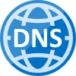
External DNS
A record: foo.example.com
IP: 52.55.80.100
Optional Addon – Auto configuration of public DNS
Allows for dynamic configuration of DNS records
Seamlessly keep public DNS in sync with your Ingress and external services
Supports Azure DNS, AWS, CloudFlare, Google DNS etc
SIG project: github.com/kubernetes-sigs/external-dns
example.com
52.55.80.100
foo
external dns
foo
Commonly used with an Ingress for host based external routing

Slide 48

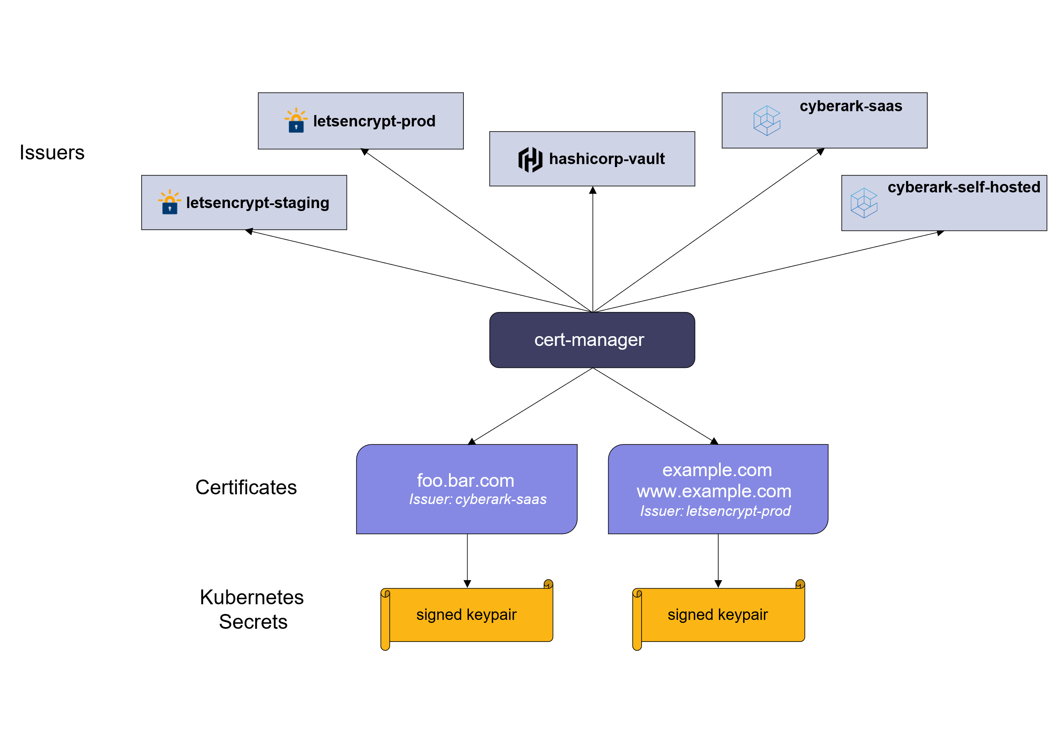
Cert Manager
cert-manager.io
Optional Addon – Automate issuing of TLS certs & manage them inside your cluster
Ensures certificates are valid and up to date
Tightly coupled to Ingress & Gateway API,
Renew certificates before expiry
Uses ACME issuers, i.e. Let’s Encrypt
Issue TLS certs for HTTPS access to services & Ingress

Slide 49

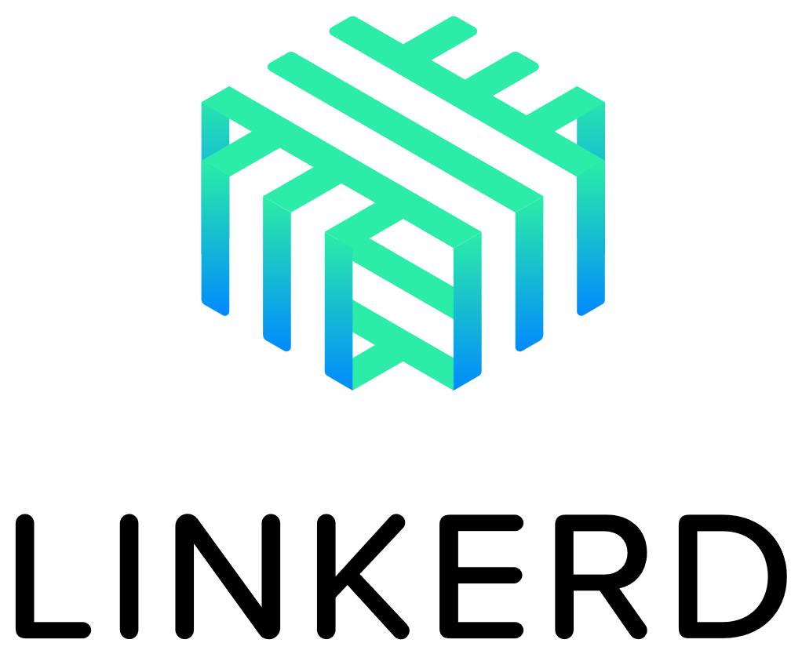

Service Mesh
Note: The Gateway API (a core part of Kubernetes) is increasingly used for traffic management, reducing the need for a full mesh
Provides advanced networking between services inside the cluster
mTLS & zero-trust — encrypt all pod-to-pod traffic automatically
Observability — distributed tracing, metrics, golden signals (via OpenTelemetry)
Traffic management — canary deployments, retries, blue-green, circuit breaking, fault injection
Consider a service mesh when you have many services and need consistent security/observability policies
Adds operational complexity — don't adopt prematurely
Most feature-rich; but complex. Now supports ambient mode (no sidecars)
Lightweight, simple, CNCF graduated
eBPF-based, no sidecars, doubles as CNI (networking layer) + service mesh

Slide 50
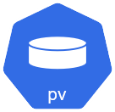
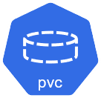

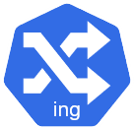
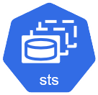
Putting It All Together
Sample Architecture – Complex App
Multi component web application, with API & DB
Ingress routing traffic to web and API pods
Ingress is exposed
to the internet
Database running in StatefulSet with internal only service and using PVC for storage, plus secrets
web
data
web
web-deployment
database
api
api-deployment

Slide 51
Debugging and Troubleshooting Workloads

Slide 52
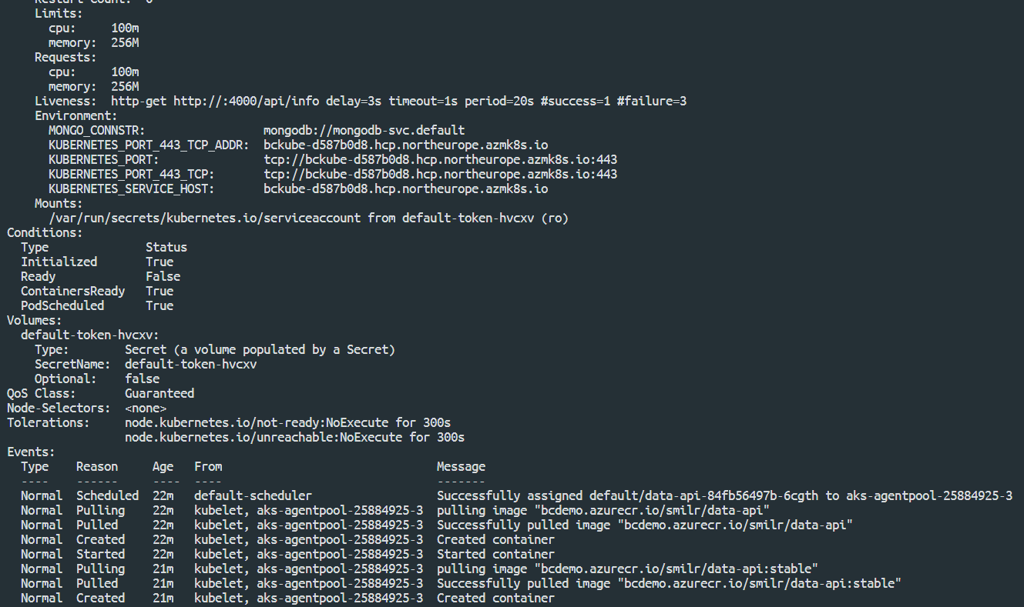
Describing Objects
kubernetes.io/docs/tasks/debug-application-cluster
Use kubectl describe to inspect status of any object in your cluster
Returns events and all properties & status details
Use label selectors to query multiple objects
$ kubectl describe deploy/data-api
$ kubectl describe pod/data-api-84fb56497b-6cgth
$ kubectl describe service/frontend
$ kubectl describe pod –l app=data-api
Uses
View and understand the status of anything in your cluster
Troubleshoot pending/failed workloads

Slide 53
Container Logs
Access stdout & stderr output from pods with: kubectl logs
Get output from a deployment or pod or single container
Follow logs with -f
$ kubectl logs deploy/data-api
Found 3 pods, using pod/data-api-84fb56497b-6cgth
> smilr-data-api@3.2.0 start /home/app
> node server.js
### Node environment mode is 'production'
### Connection attempt 1 to MongoDB server mongodb-svc.default
### Yay! Connected to MongoDB server
### Server listening on 4000
Uses
View any errors output from containers
See what your workloads are doing

Slide 54
Debug & Get Shell Access
kubernetes.io/docs/tasks/debug-application-cluster/get-shell-running-container
Use kubectl exec to run commands inside a pod/container
Use -it switch and sh or bash to create an interactive shell
Use kubectl debug to attach to distroless containers or to create an interactive sidecar in a pod
$ kubectl exec mypod -- ps -ef
PID USER TIME COMMAND
1 root 0:00 npm
22 root 0:00 node server.js
36 root 0:00 ps –ef
$ kubectl exec -it mypod -- bash
bash-4.4#
$ kubectl debug -it mypod --image=alpine –-target=appcnt
/ #
$ kubectl debug -it mypod --image=alpine
/ #
Run a single command
Run a single command
Uses
Low level debugging
Interactive troubleshooting inside the cluster and/or pods

Slide 55
A Few Problems & Possible Causes
There’s 100s more to find!👍
Pattern | Symptom | Likely Cause
ImagePullBackOff | Pod stuck, never starts | Wrong image name/tag, missing registry credentials, or private registry not configured
CrashLoopBackOff | Pod starts then restarts repeatedly | App crashing on startup, bad config, missing env vars, failed DB connection
Pending pods | Pod stays in Pending state | Insufficient CPU/memory on nodes, no nodes match nodeSelector/affinity, or PVC can't bind
OOMKilled | Container killed unexpectedly | Memory limit too low, app exceeds its resource limit or real memory leak
Service not reachable | Can't connect to pods | Label/selector mismatch between Service and Pods, wrong port/targetPort, or no endpoints
Ingress returns 404/502 | External traffic fails | Misconfigured ingress rules, wrong service name, or backend pods not ready, controller dead/missing
Readiness probe failing | Pod running but gets no traffic | Probe path/port wrong, app slow to start, or missing startup probe
ConfigMap/Secret not found | Pod fails to start | Typo in name, resource in wrong namespace, or not created yet
Node NotReady | Workloads evicted | Node resource pressure (disk/memory), kubelet crashed, or network issues
CreateContainerConfigError | Pod stuck in waiting | Referenced ConfigMap or Secret doesn't exist or has wrong key name
Evicted pods | Pods terminated unexpectedly | Node under disk or memory pressure, resource limits not set
Volume mount hangs | Pod stuck in ContainerCreating | PV stuck in wrong availability zone, or cloud disk still attached to another node
Rolling update stuck | Deployment half-updated | New pods failing readiness probes, bad health endpoint, so rollout never completes
Network policy blocking traffic | Sudden connectivity loss | Default-deny policy applied but allow rules missing for the new service
HPA not scaling | HPA shows <unknown> targets | Metrics Server not installed, or no resource requests set on containers
Jobs never complete | Jobs stuck running | Container exits with non-zero code, restartPolicy set to Always instead of Never/OnFailure
Namespace stuck ‘Terminating’ | Can't delete namespace | Finalizers on resources inside. typically CRDs or webhook dependencies blocking cleanup

Slide 56
Advanced Pod Configuration

Slide 57
Deeper Dive on Manifests
?? So what do all these labels mean ??
Manifests for Deployments, StatefulSets and DaemonSets have a similar pattern & structure
The spec part contains replicas and a selector and also a template for the objects it will replicate
The template will contain another spec, typically a Pod spec
A Pod spec contains one or more containers
kind: Deployment
apiVersion: apps/v1
metadata:
name: my-deployment
labels:
cheese: cheddar
spec:
replicas: 1
selector:
matchLabels:
thing: my-app
template:
metadata:
labels:
thing: my-app
cake: chocolate
spec:
containers:
- name: my-container
image: nginx
Deployment name will also be used as name prefix for the
ReplicaSet and Pods
Labels for the deployment are
optional
The selector of the spec MUST match one label in the template
Required field but mostly not important

Slide 58
Init Containers
kubernetes.io/docs/concepts/workloads/pods/init-containers
Init Containers are optional special containers that run only once when a pod is started
Init containers run to completion (terminate)
Main containers in a pod will not start until all Init Containers have run
...
initContainers:
- name: init-mysql
image: bencuk/mysqldb
command: ["./scripts/checkDB"]
...
initContainers:
- name: init-demodata
image: bcdemo.azurecr.io/smilr/data-api
command: ['sh', '-c', 'cd demoData && node demodb.js']
env:
- name: MONGO_CONNSTR
value: mongodb://mongodb-svc.default
- name: WIPE_DB
value: "true"
Uses
Application configuration
Bootstrapping apps
Running utility & start-up scripts
Data injection

Slide 59
Sidecars
kind: Pod
metadata:
name: monitored-webapp
spec:
containers:
- name: webserver
image: nginx
initContainers:
- name: log-monitor
restartPolicy: Always
image: my-log-monitor
args: ["--log-dir", "/var/logs/nginx"]
Pods co-locate multiple containers together, sharing network and storage
Sidecar is a pattern where additional containers provide enhancing/optional capabilities
Bind containers together to form a single cohesive unit of service
Since Kubernetes 1.33, sidecars are natively defined as init containers with restartPolicy: Always
The important part!
Pod
Container
nginx
Container
(sidecar)
logmon
Uses
Decompose architecture
Build services incrementally
Bolt on features
/var/logs/nginx

Slide 60
Node Selector
kubernetes.io/docs/concepts/configuration/assign-pod-node/#nodeselector
kind: Pod
metadata:
name: machineLearning
spec:
containers:
- name: trainModel
image: ml-image:latest
nodeSelector:
hardware: gpu
Pod
A simple constraint to which Nodes are eligible to run a Pod
Key value pairs of labels, to be matched against Node’s labels
Not a ‘hard rule’, other Pods that have no nodeSelector can still land on the node
Can be scheduled on
Name: aks-nodepool1-18655374-vmss000000
Roles: agent
Labels: agentpool=nodepool1
beta.kubernetes.io/arch=amd64
hardware=gpu
Uses
Node
Assign workloads requiring special hardware or resources, e.g. GPU
Physical partitioning of cluster
Separating noisy Pods

Slide 61
Affinity and Taints
kubernetes.io/docs/concepts/configuration/taint-and-toleration/
kubernetes.io/docs/concepts/configuration/assign-pod-node/#affinity-and-anti-affinity
$ kubectl taint nodes myNode001 team=team1:NoSchedule
node/myNode001 tainted
kind: Pod
spec:
tolerations:
- key: team
operator: Exists value: "team1"
effect: NoSchedule
Affinity and anti-affinity provide advanced ways to control Pod placement - ‘Hard’ rules and ‘soft’ rules - Weighting and expressions
Taints and Tolerations. Taints are applied to Nodes and will not accept Pods that don’t have a matching Toleration
Unlike taints & nodeSelectors, affinity rules can also apply to pods. i.e. do or don’t schedule these pods together
kind: Pod
spec:
affinity:
nodeAffinity:
requiredDuringSchedulingIgnoredDuringExecution:
preferredDuringSchedulingIgnoredDuringExecution:
podAffinity:
requiredDuringSchedulingIgnoredDuringExecution:
preferredDuringSchedulingIgnoredDuringExecution:
Uses
Assign workloads requiring special hardware or resources, e.g. GPU
Physical partitioning of cluster
Separating noisy Pods

Slide 62
Pod Security
kubernetes.io/docs/concepts/security/pod-security-standards/
By default, your pods can do a lot of things you might not want!
Use Pod Security Standards & Pod Security Admission Controller to enforce security practices
Three built-in security levels: Privileged - unrestricted (default) Baseline - prevents known privilege escalations Restricted - hardened best practice (non-root)
Any pod that violates the profile can be rejected at admission, and/or you'll also get warnings and audit log entries
apiVersion: v1
kind: Namespace
metadata:
name: production
labels:
pod-security.kubernetes.io/enforce: restricted
pod-security.kubernetes.io/warn: restricted
pod-security.kubernetes.io/audit: restricted
Apply ‘restricted’ policy
apiVersion: v1
kind: Pod
metadata:
name: bad-pod
spec:
containers:
- name: app
image: nginx
REJECTED!
- Doesn't set runAsNonRoot: true
- Doesn't set allowPrivilegeEscalation: false
- Doesn't drop all capabilities
- Doesn't set a seccompProfile
Uses
Security!

Slide 63
Scaling

Slide 64
Manually Scaling
Scale stateless workloads by controlling the number of replicas of a Deployment
Be careful scaling StatefulSets, unless the workload/application is “cluster aware”
DaemonSets don’t require scaling
$ kubectl scale deploy/myApp --replicas=5
deployment.extensions/myApp scaled
OR
kind: Deployment
apiVersion: apps/v1
metadata:
name: myApp
spec:
replicas: 2
Uses
Horizontally scale
Distribute work around cluster
Remove single points of failure
5

Slide 65
Horizontal Pod Autoscaler (HPA)
Automatically scale stateless workloads
Use to horizontally scale stateless Pods in ReplicaSet/Deployment
Rules define desired Pod replica count based on observed metrics
Takes metrics from the metrics API fed from the Metrics Server
Supports extension via custom metrics
pod 1
…
pod n
Deployment
Scale
metrics data
- Increase replicas
- Decrease replicas
Metrics Server
Horizontal Pod Autoscaler
Dynamically scale stateless workloads across available nodes

Slide 66

Cluster Autoscaler (CA)
Automatically scale cluster resources
Additional node(s) needed
CA
Pods are in pending state
Adjusts the size of the Kubernetes cluster, adding & removing Nodes when - Pods are pending state due to insufficient resources (scale out) - Nodes have been underutilized for a period of time (scale in)
Tightly coupled to the cloud and environment hosting the cluster & Nodes
Pod
Pod
New Node is brought online
Pending pods are scheduled
Node
New Node
Pod
Pod
Pod
Pod
Kubernetes Cluster
Scale cluster wide by adding/removing Nodes

Slide 67
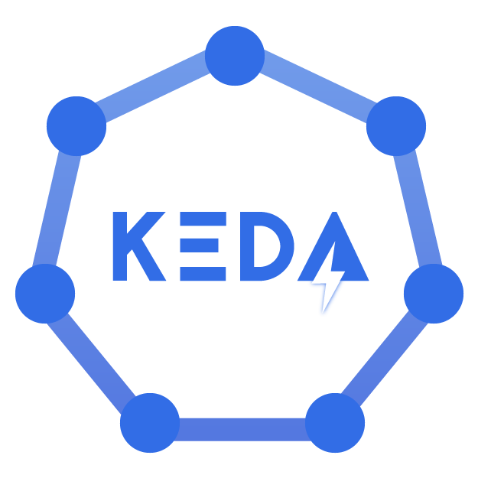
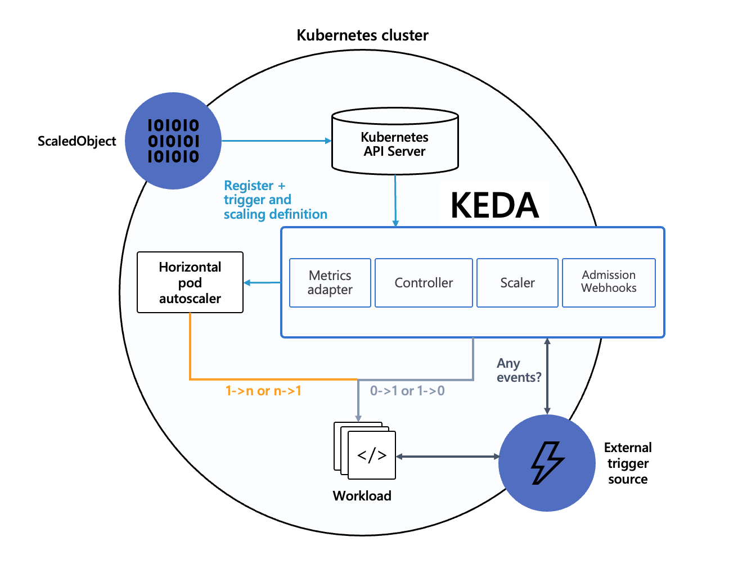
KEDA
https://keda.sh/
Event-driven autoscaling - scale on external metrics, queues, and events
KEDA is a Kubernetes add on that helps scale applications based on real-world events
KEDA can adjust the size & number of your containers automatically, depending on the workload like the number of messages in a queue or incoming requests.
Works alongside Kubernetes components like the Horizontal Pod Autoscaler
Over 80 different ‘scalers’ available, each providing a different source of events to base scaling rules on

Slide 68
Extending Kubernetes
Extra Advanced

Slide 69
Custom Resources Definitions (CRDs)
Extend the Kubernetes API and object model
apiVersion: apiextensions.k8s.io/v1
kind: CustomResourceDefinition
spec:
names:
plural: pets
kind: Pet
openAPIV3Schema:
type: object
properties:
petName:
type: string
An extension of the Kubernetes API that is not available in a default Kubernetes installation
Can represent application specific or generalised entities, e.g. BackupJob, Report
A CRD is schema & state – doesn’t define behaviour
Manage via the API & kubectl same as standard built-in resource types
$ kubectl get pets
Extend Kubernetes with new entities and data models

Slide 70
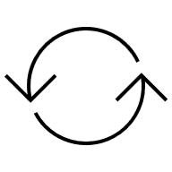
Operators
The Operator pattern: CRD + Custom Controller
crud
Custom Resource
An operator is custom controller that acts on a given set of CRDs – defines behaviour
Controller is run as a regular pod & deployment
Custom operator reconciler code subscribes to the Kubernetes API & watches for CRD changes
user
tracking
change
events
Operator
state
reconcile
Discover & use:
artifacthub.io
operatorhub.io
Build your own:
Kubebuilder
KUDO
Operator SDK
A common and easily understood way to extend Kubernetes

Slide 71
DevOps & Observability

Slide 72

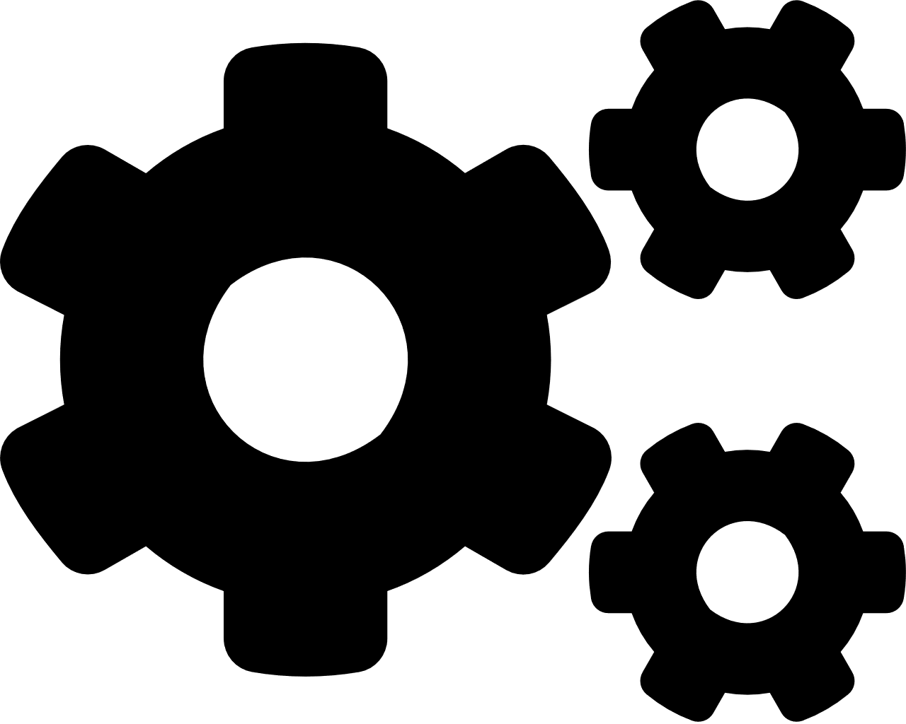





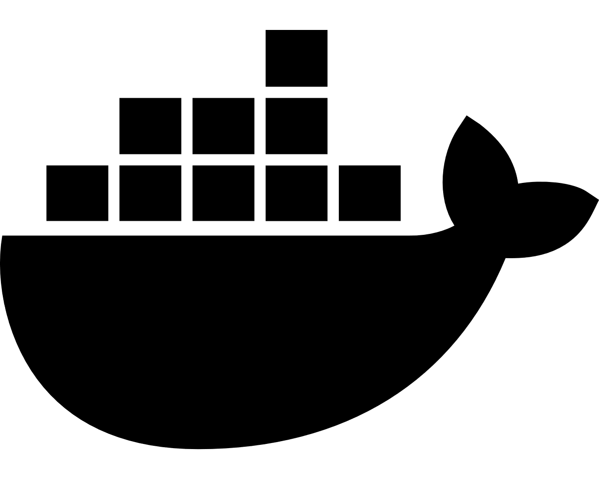
Common DevOps Containers Lifecycle
CI/CD flow with pipelines/workflows and Helm
CI
CD
git
Container Build
Pipeline
Trigger / Webhooks
Container Registry
Release
Pipeline
Inner Loop
Test
Repair Items / Fixes
Staging
$ docker build/run
$ make run-tests
$ git push
Developer
Observability / Events
Prod

Slide 73
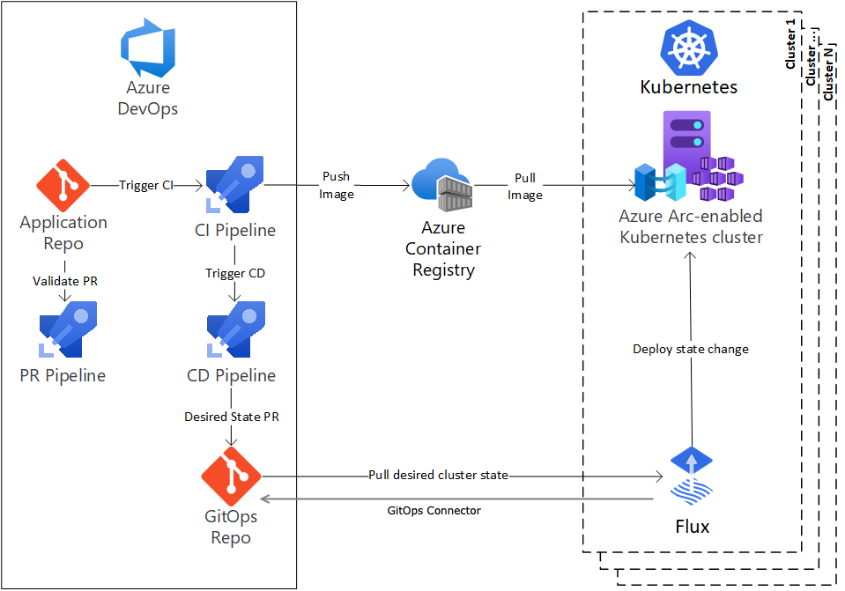
GitOps
Declarative approach to IaC & continuous deployment
GitOps is relatively new approach & a set of practices & tools to manage your infrastructure application configurations using Git as desired state
A “pull” approach vs “push” – special controllers (e.g. Flux, Argo CD) in Kubernetes watch and poll for changes and reconcile the updates.
More complex & not as well adopted as the Helm/kubectl push CD flow but has some advantages.
Alternative approach for managing and deploying applications to Kubernetes

Slide 74


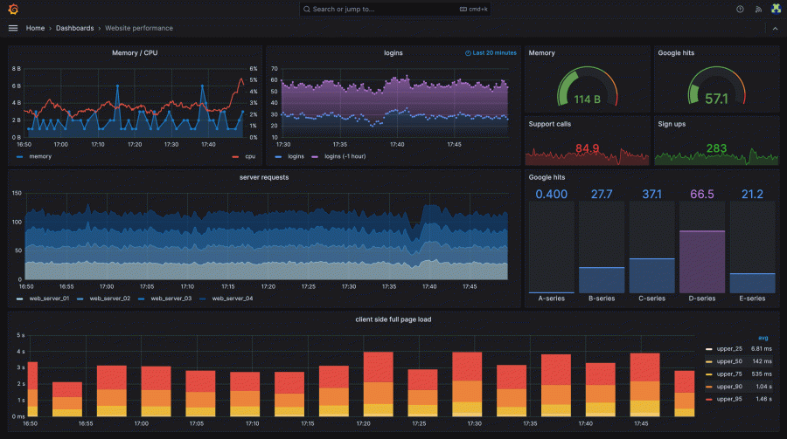

Modern Observability Stack
Prometheus & Grafana — the standard for Kubernetes monitoring
Prometheus — Metrics Collection
Pull-based model: scrapes metrics from pods and services at regular intervals – no agents
Pods & Nodes expose a /metrics endpoint; Prometheus discovers targets automatically
Stores time-series data with a powerful query language (PromQL)
Powers alerting via Alertmanager
CNCF graduated project — the default metrics standard for Kubernetes
Grafana — Visualization & Dashboards
Connects to Prometheus as a data source
Rich, customizable dashboards for cluster health, pod performance, and application metrics
Thousands of pre-built community dashboards available
Supports additional data sources: Azure Monitor, Loki (logs), Tempo (traces)
OpenTelemetry — The Source
Vendor-neutral standard for collecting metrics, logs, and traces from your applications
Instrument once, export to Prometheus, Grafana, Jaeger, or any backend

Slide 75



Helm
Package Manager for Kubernetes
Helm simplifies deployment into Kubernetes using charts
A chart consists of one or more Kubernetes YAML templates + supporting files
Helm charts support dynamic parameters & functions important for automated pipeline deployments
Thousands of charts exist for standard software, tools & packages
https://helm.sh
- Use Helm to install software/apps in your cluster - Create Helm charts for your own apps, for CI/CD releases

Slide 76

Helm – The Basics
docs.helm.sh/glossary
helm | Client tool to manage and work with Helm
Chart | Package of Kubernetes resources in template form
Template | Kubernetes YAML with directives in Go template language format, e.g. {{ blah }}
Release | When installing a chart into Kubernetes it becomes a release
Values | Used at install time to customise the release, either from CLI or file
Dependency | A chart can require other external charts, Helm will automatically pull/update
Chart: mychart/
+
values.yaml
+
helm
foo Pods
foo-pods
$ helm install foo ./mychart -f values.yaml
Release:
foo
foo Services
foo-services

Slide 77

Kustomize
https://kustomize.io/
Kubernetes native manifest configuration & parametrization
Kustomize is a tool for customizing Kubernetes configurations
It updates manifests on the fly to add, remove or update configuration options.
Standalone CLI tool and a native part of kubectl
Achieves similar outcomes to Helm but uses a very different paradigm of bases + overlays + patches
Used for environment-specific config (dev/staging/prod)
/base/
deployment.yaml
service.yaml
kustomization.yaml
/overlays/dev/kustomization.yaml
/overlays/staging/kustomization.yaml
/overlays/prod/kustomization.yaml
Kustomize requires you to think about your directories and file placement
$ kubectl apply –kustomize /overlays/prod/
Out of the box & template-free way to customize application configuration

Slide 78

Azure Kubernetes Service

Slide 79


Managed Kubernetes on Azure – AKS
Azure managed control plane
Automated upgrades, patches
High reliability, availability
Easy, secure cluster scaling
Self-healing
API server monitoring
At no charge
App/ workload definition
Kubernetes API endpoint
etcd Store
User
API server
Controller Manager
Cloud Controller
Scheduler
Azure Kubernetes Service AKS
Azure core network
Customer Nodes
Container Runtime
Container Runtime
Container Runtime
Container Runtime
Container Runtime
Pods
Pods
Pods
Pods
Pods

Slide 80
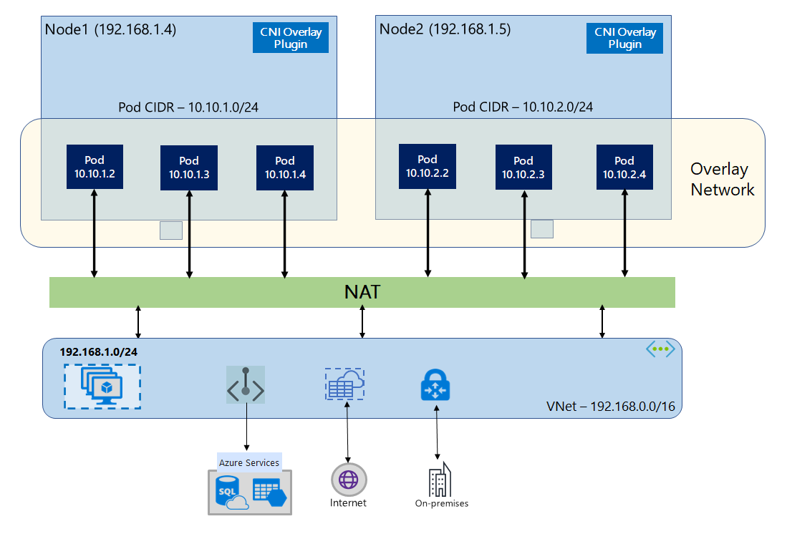
AKS Networking
VNet Peering / ExpressRoute — Connect to on-premises and other Azure VNets
Private Clusters — API server not exposed to the internet
Service Endpoints / Private Link — Secure access to Azure PaaS services from pods
Networking Modes
Azure CNI Overlay (Recommended) Nodes join your VNet; pods get IPs from a private CIDR overlay. Simple, scalable, no IP exhaustion issues
Azure CNI with Vnet Both nodes and pods get IPs from your VNet subnet. Full VNet integration but requires careful IP planning
Azure CNI Powered by Cilium eBPF-based dataplane replacing kube-proxy. Adds network policy, observability, and service mesh capabilities
Kubenet (Legacy) Pods sit behind a bridge with UDR routing. Simple but limited; not recommended for new clusters
Azure CNI Overlay

Slide 81
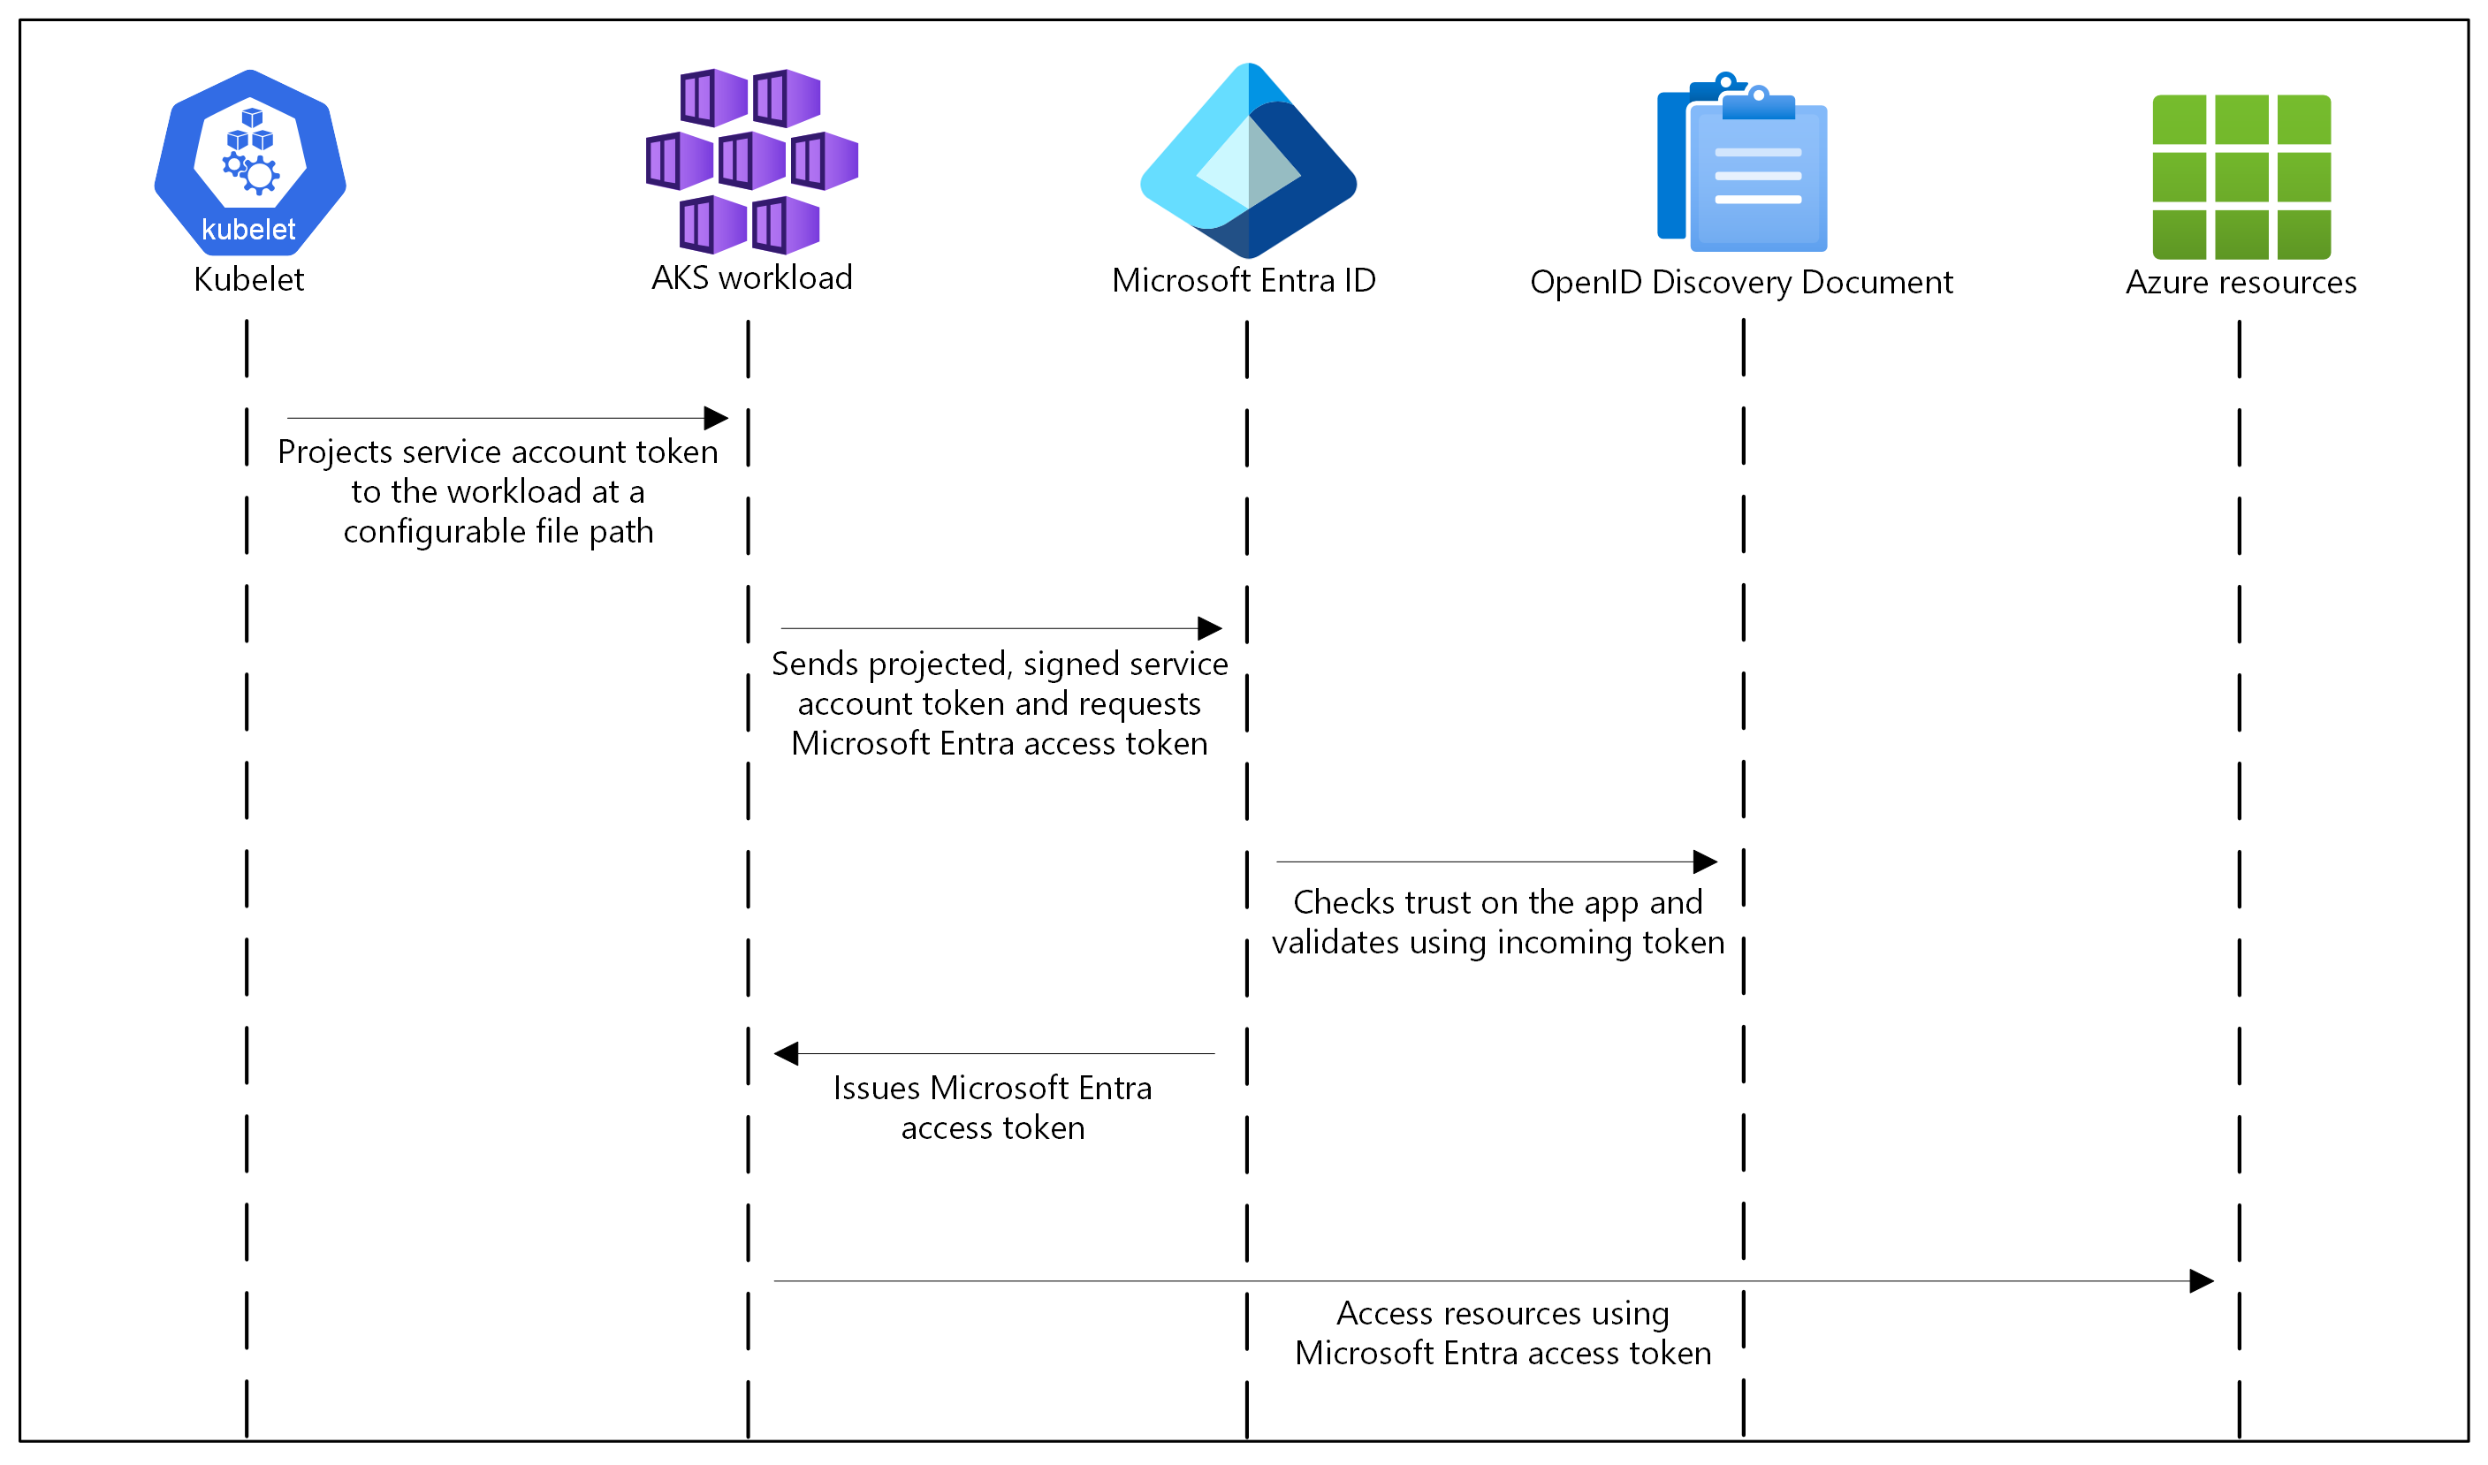
Microsoft Entra Workload ID
learn.microsoft.com/azure/aks/workload-identity-overview
Allows your Pods to authenticate and obtain tokens to access resources in Azure via managed identities in Entra ID
Workload (i.e. your code) should be using MSAL & Azure Identity client libraries
Replaces the deprecated ‘Pod managed identity’ approach
Uses a combination of OIDC federation and ServiceAccount token volume projection
Azure Key Vault
A common use case for Workload Identity is access to Azure Key Vault for obtaining secrets

Slide 82
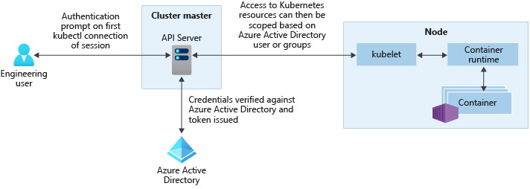
Microsoft Entra ID for RBAC
learn.microsoft.com/azure/aks/enable-authentication-microsoft-entra-id
Use Microsoft Entra ID to govern and control cluster access
Assign roles & permissions in Kubernetes RBAC, based on EntraID users & groups
Roles & groups in EntraID define who has access to the cluster
Downsides: Requires extra tools like kubelogin to access the cluster

Slide 83
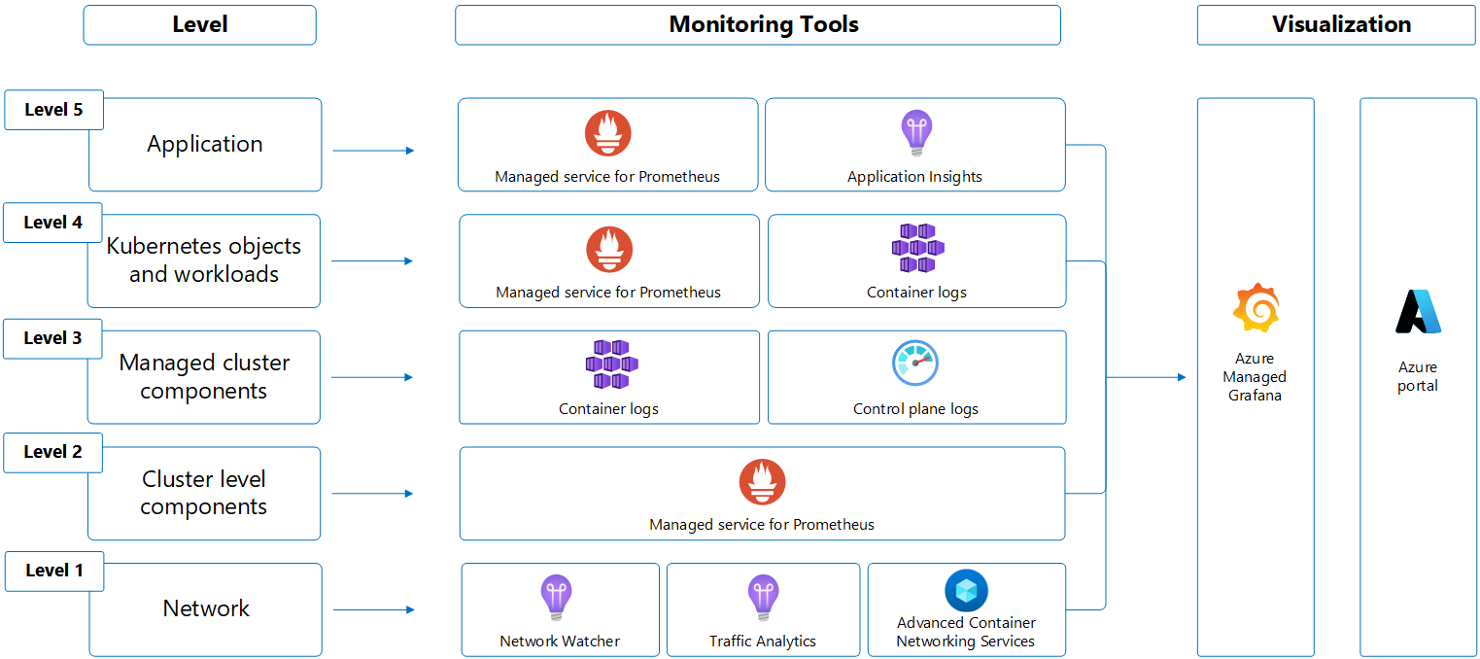
Azure Monitor Container Insights
learn.microsoft.comazure/azure-monitor/containers/kubernetes-monitoring-overview
Observability and monitoring for AKS clusters
Fully integrated monitoring for AKS within the Azure Monitor platform
Collects metrics, logs, and events from nodes, pods, and containers automatically
Pairs with Azure Managed Prometheus for metrics collection and Azure Managed Grafana for dashboards
Sends data to a Log Analytics workspace for querying with KQL
- Cluster health dashboards with drill-down from cluster → node → pod → container
- Live container log streaming
- Recommended metric-based alerts out of the box
- Integration with Azure Managed Prometheus and Azure Managed Grafana for a full observability stack (or bring your own)

Slide 84
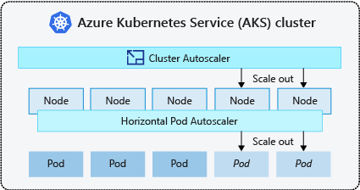
Cluster Auto Scaler
docs.microsoft.com/azure/aks/cluster-autoscaler
Node & infra autoscaling with Azure Scale Sets
Enables the standard Kubernetes Cluster Autoscaler (CA)
HPA scales your workload by adding pods, and the Cluster Autoscaler scales your infrastructure by adding nodes when those new pods can't be scheduled
Leverages Azure VM Scale Sets
Settable per node pool if using multiple pools
--enable-cluster-autoscaler
--min-count 1
--max-count 8

